Slide 1
Microsoft Azure Overview
Microsoft Research
Microsoft Azure for Research Training

Slide 2
Microsoft Azure Overview
Key learning objectives
Cloud computing basics
Patterns and terminology – IaaS, PaaS, and SaaS
Microsoft Azure basics
Virtual machines
Building blocks – storage
Cloud services

Slide 3
What is the Cloud?
“An approach to computing that’s about internet scale and connecting to a variety of devices and endpoints.”
“Treating hardware and software resources as a utility.”
“A way to save a ton of money by only paying for what you need.”
“A way to scale huge when you need something done fast.”

Slide 4
On and Off
Cloud Computing Patterns
Inactivity
Period
On & off workloads (e.g. batch job)
Over provisioned capacity is wasted
Time to market can be cumbersome
Compute
t
Growing Fast
Compute
Successful services needs to grow/scale
Keeping up w/ growth is big IT challenge
Cannot provision hardware fast enough
t
Unpredictable Bursting
Compute
Unexpected/unplanned peak in demand
Sudden spike impacts performance
Can’t over provision for extreme cases
t
Predictable Bursting
Compute
Services with micro seasonality trends
Peaks due to periodic increased demand
IT complexity and wasted capacity
t
Notes:
Most researchers won’t care about cost; they will care about scaling their research or “pushing through a huge amount of analysis before a conference;” most researchers do not see the costs because it’s paid for through a grant; business examples are not relevant to most researchers; mention collaboration; as in “the cloud makes it easier for researchers to collaborate”

Slide 5


Cloud Computing Variants
Traditional Software
Infrastructure
(as a Service) (IaaS)
Platform
(as a Service) (Paas)
Software
(as a Service) (SaaS)
Applications
Applications
You manage
Applications
Applications
Data
You manage
Data
Data
Data
Runtime
Runtime
Runtime
Runtime
Managed by vendor
You manage
Middleware
Middleware
Middleware
Middleware
Managed by vendor
O/S
O/S
O/S
O/S
Virtualization
Virtualization
Managed by vendor
Virtualization
Virtualization
Servers
Servers
Servers
Servers
Storage
Storage
Storage
Storage
Networking
Networking
Networking
Networking
Notes:
Capture research domains in the IaaS, PaaS, SaaS examples
(IaaS) not having to manage a cluster for your research
(PaaS) running Python scripts for your research
(SaaS) providing weather simulations to your collaborators where they just enter parameters

Slide 6
Infrastructure as a Service
National Flood Interoperability Experiment
https://www.cuahsi.org/NFIE
U. of TX, Austin, U. of CA, & U. of IL, Urbana-Champaign
Flood prediction system
Needed to scale out custom software
RAPID (Routing Application for Parallel Computation of Discharge)
Used Azure Virtual Machines
Needed big storage too
Goal is 2.67M monitoring locations nationally

Slide 7
Platform as a Service
Molplex: Clouds against Disease
Spun off from VENUS-C (EU funded project) at Newcastle U.
http://molplex.com
Looks for toxicity prediction to speed up drug research
Sifts through massive databases looking for chemical structure and biological effect
Built on worker-role implementation
Researchers submit “Generic Worker” job; system handles the rest

Slide 8
Software as a Service
Readmissions Score as a Service
U. of WA, Tacoma
http://cwds.uw.edu/readmissions-score-serviceraas-0
Predicts the risk-of-readmission factor for medical patients
20% of Medicare patients readmitted; cost $26B a year
Built entirely on Azure Machine Learning
Exposed as a web service
Helps hospitals focus on high-risk patients and reduce costs

Slide 9
Microsoft Azure LOVES EVERYONE!
Whatever client operating system you use
Whatever server operating system you want to use
100% cross-platform with massive open-source support

Slide 10
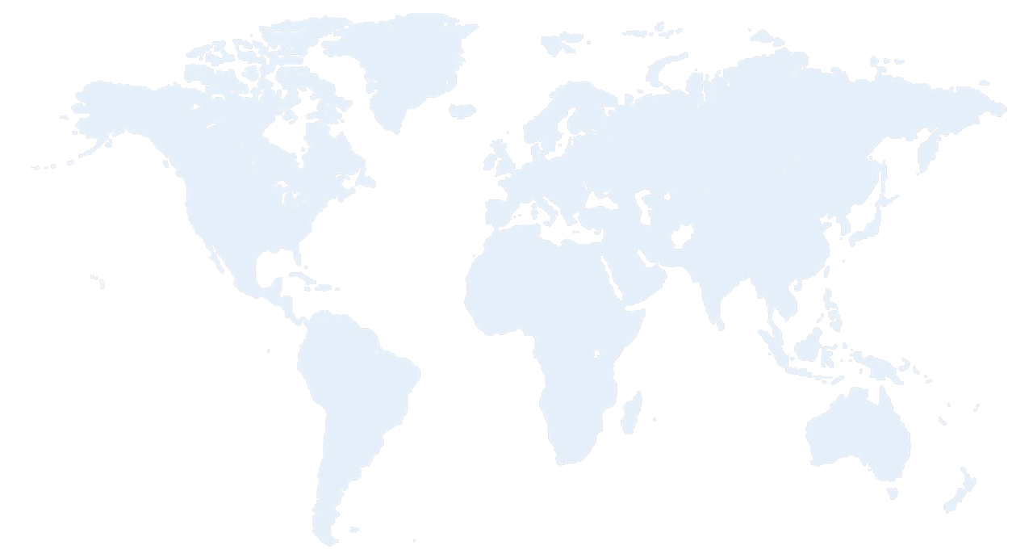


Azure Datacenter Regions
North America
Europe
Asia Pacific
N. Europe
Central US
N. Central US
W. Europe
Japan West
West US
China North
Japan East
East US
East US 2
Central India
China South
S Central US
E. Asia
S.E. Asia
West India
Brazil South
South India
Australia East
Australia Southeast
Notes:
Prepare to be asked about U.S. jurisdiction over international data centers; compare to Gmail if they “get grumpy” and don’t want to use Azure for this reason
Maybe a brief overview of security on the "world" slide. People think that the cloud is publicly visible (naïve users). Others might need to protect the IP of the companies they do research with (e.g., agricultural research funded by Monsanto). Talk about HIPAA compliance and/or government security compliance.

Slide 11
>250k
Greater than
1,500,000
>500m
Azure Active Directory Users
Active websites
SQL Databases in Azure
>1
>777
TRILLION storage
transactions per day
>80%
Fortune 500
Use Azure
MILLION
Developers registered with Visual Studio Online
>1.5
TRILLION messages/mo processed by
Azure IoT
>13
BILLION
authentications/wk

Slide 12
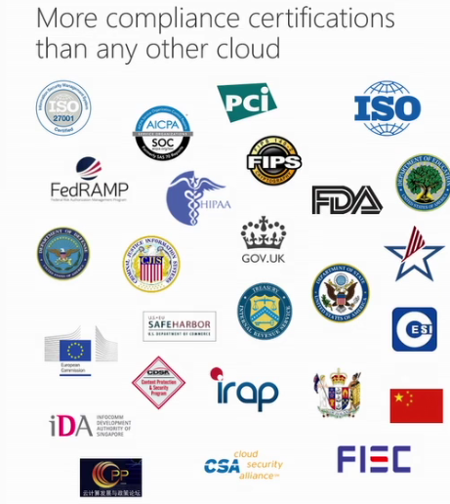
Security and Compliance
See the full list
https://azure.microsoft.com/en-us/support/trust-center/compliance/
Full HIPPA compliance
Multiple national government compliance
Strict privacy adherence
EU Model Clauses
Safe Harbor
ISO/IEC 27018

Slide 13
Microsoft Azure Services (Partial List)
Compute
Virtual Machines
Cloud Services
Batch
Web & Mobile
Web Apps
Notification Hubs
Data & Storage
DocumentDB
Redis Cache
SQL Database
Blob storage
Azure Search
Analytics
HDInsight
Machine Learning
Stream Analytics
Event Hubs
Networking
VPN
Express Route
Media & CDN
Media Services
Full CDN
Identity & Access Management
Azure Active Directory

Slide 14
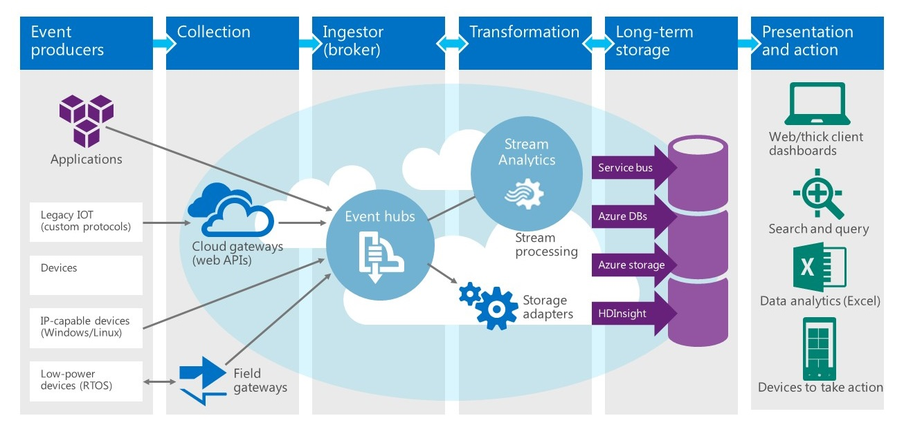
Azure Services Work Together

Slide 15
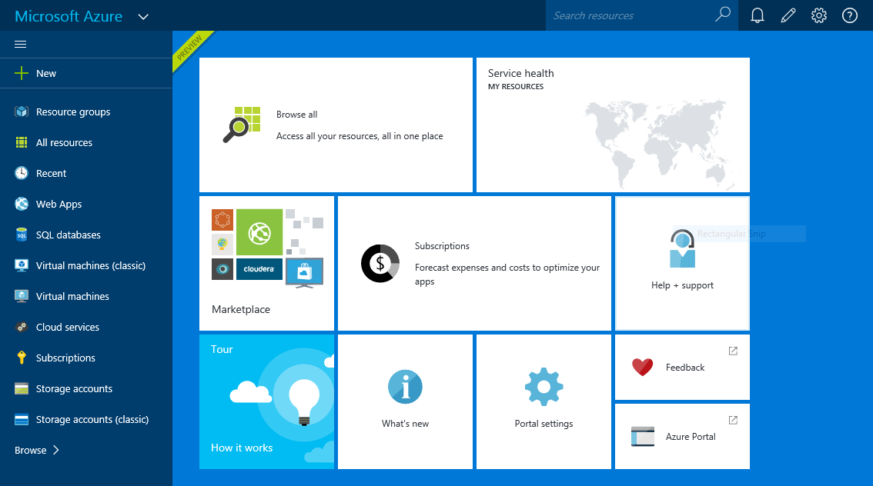
Microsoft Azure Portal
Life begins at https://portal.azure.com

Slide 16
Hands-On Lab!
Creating Your Free Accounts
Introduction Creating Accounts HOL

